Slide 1

Clustering Books Based on their Contents
15CSE358
Natural Language Processing
Case Study Report
Anjali Ragupathi (CB.EN.U4CSE17307)

Slide 2
Objective
To train a topic modelling algorithm – LDA – on a corpus of books and determine the latent themes
To perform hyperparameter tuning and data cleaning for optimization
To predict similar books based on the plot of a user-entered book, by looking at books with similar themes.

Slide 3
Problem Statement
There is a need to build more functional and relevant recommendation engines and algorithms not based only on explicitly mentioned features, but on hidden themes that run through a number of related documents. Thus, alternative solutions like topic modelling must be explored.
Statement: To find themes present in document corpus and use them to group and classify books.

Slide 4
Related Work
Paper on using POS tagging for improved topic modelling by Martin & Johnson.[1]
  Used POS tagging before lemmatization to retain only nouns and verbs, and reduce most frequent modals and auxiliary verbs.
Book recommendation systems based on LDA and the CMU Dataset [2]

Slide 5
Novelty of the Work
Using Web Scraping from Wikipedia to get the text of the plot of an entered book and then retrieving the topics.
Using the retrieved topics to find the nearest topic cluster and hence the nearest books related to it.

Slide 6
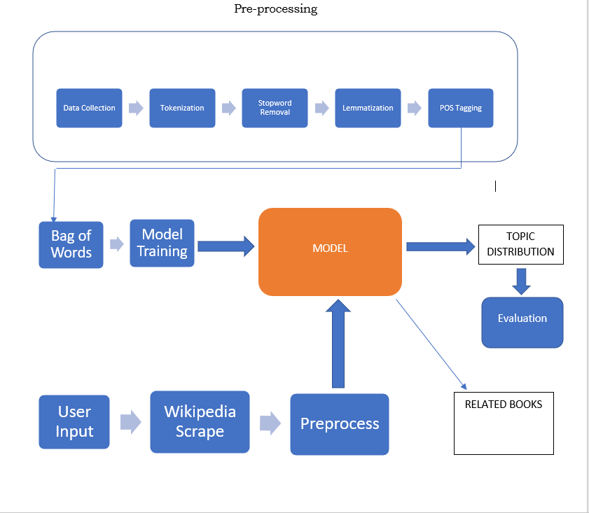
Architecture

Slide 7
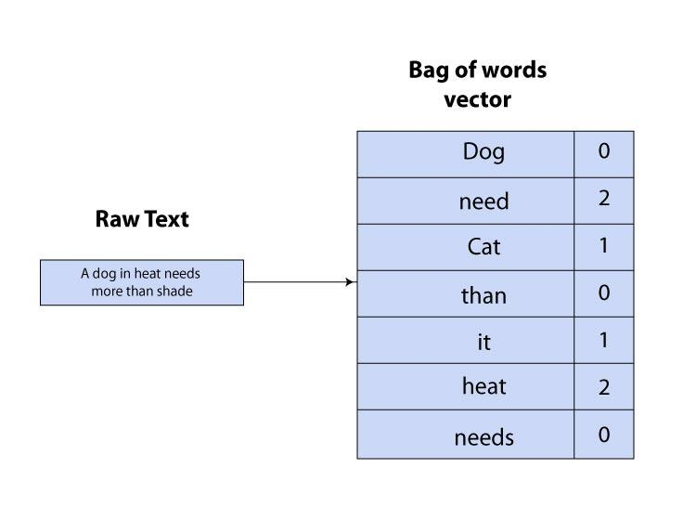
Data Preprocessing
Tokenization
Stopword Removal
Lemmatization
POS Tagging
Filtering by frequency
Bag of Words
Image source

Slide 8
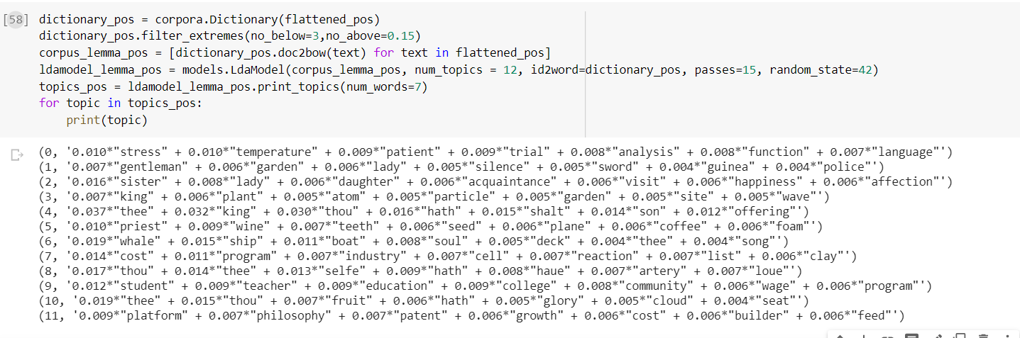
Implementation
Base implementation

Slide 9
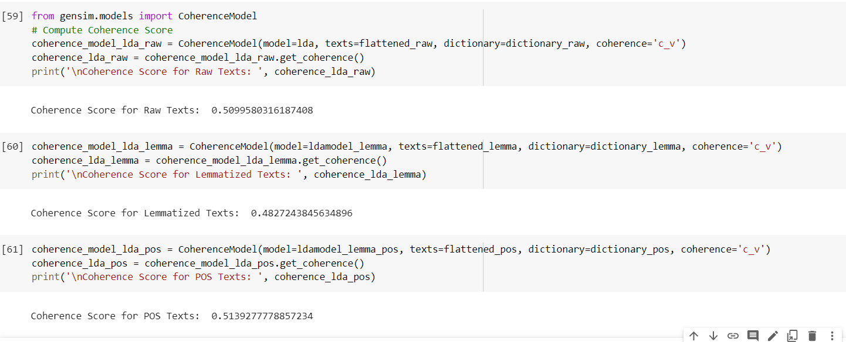
Performance Metric : Coherence
Coherence is a measure of the semantic similarity between the words in a topic.
A higher coherence score means that the topics are more related and interpretable.

Slide 10
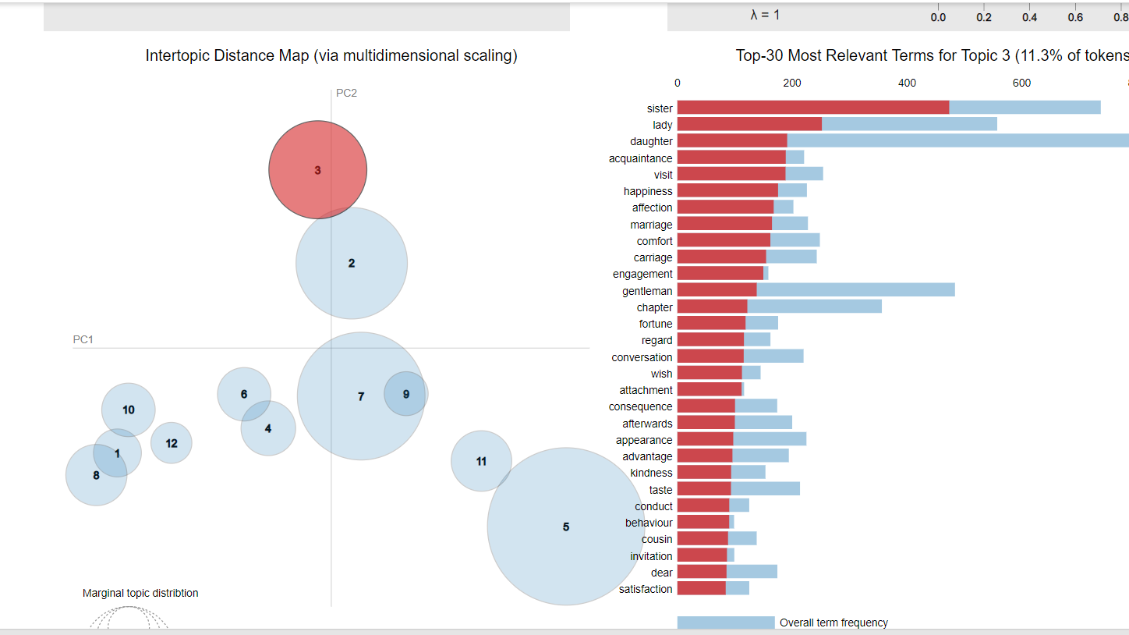
Visualization

Slide 11
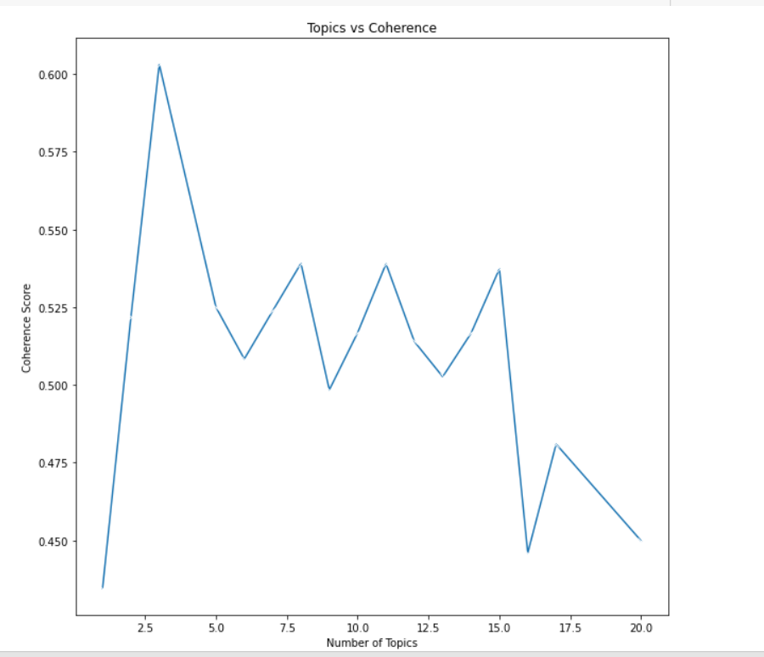
Hyperparameter Tuning: Topic number

Slide 12
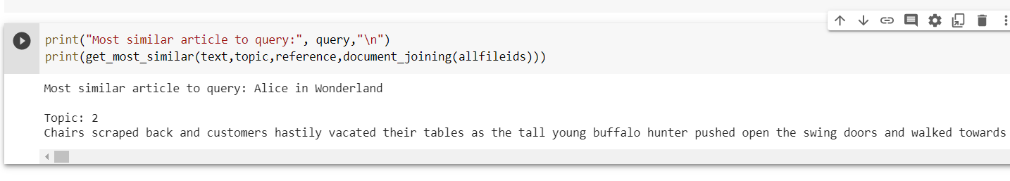
Predictions

Slide 13
References
Martin, Fiona, and Mark Johnson. "More efficient topic modelling through a noun only approach." Proceedings of the Australasian Language Technology Association Workshop 2015. 2015.
https://humboldt-wi.github.io/blog/research/information_systems_1819/is_lda_final/
https://towardsdatascience.com/topic-modelling-in-python-with-nltk-and-gensim-4ef03213cd21
https://towardsdatascience.com/evaluate-topic-model-in-python-latent-dirichlet-allocation-lda-7d57484bb5d0

